Slide 1


Performance Evaluation with
Java Modelling Tools
Giuliano Casale
Department of Computing
Imperial College London, UK
Joint work with:
Giuseppe Serazzi (Politecnico di Milano, Italy)
Lulai Zhu (Imperial College London, UK)

Slide 2
Outline
Introduction
Activity 1: getting started
Activity 2: load balancing
Activity 3: parameter sweeping
Activity 4: capacity constraints
Activity 5: workflows & fork-join
Please download the latest JMT (v1.0.2) here:
  http://jmt.sf.net/Download.html

Slide 3
Introduction

Slide 4
Java Modelling Tools
Simulation and analysis of queueing networks.
Project started in 2002 at Politecnico di Milano, since 2010 co-developed at Imperial.
JMT is open source: GPL v2,
  Medium-size project: ~1,000 classes
  JAR, source code and maven build files (pom.xml) http://jmt.sourceforge.net/Download.html
Good diffusion (59k downloads, mostly from the US)
Community interaction mainly through
  Bug reports
  Feature requests
  Templates

Slide 5
Supported models
Queueing Systems
Queueing Networks (QN)
  Product-form
  Extended (fork/join, blocking, priorities, …)
Petri Nets (PN)
  Stochastic Petri Nets (SPN)
  Generalized Stochastic Petri Nets (GSPN)
  Coloured Petri Nets (CPN)
Queueing Petri Nets (QPNs)

Slide 6

Who uses JMT?
JMT is for PE practice, teaching, and research
Several university courses worldwide (tell us!)
Supporting materials available on website

Slide 7
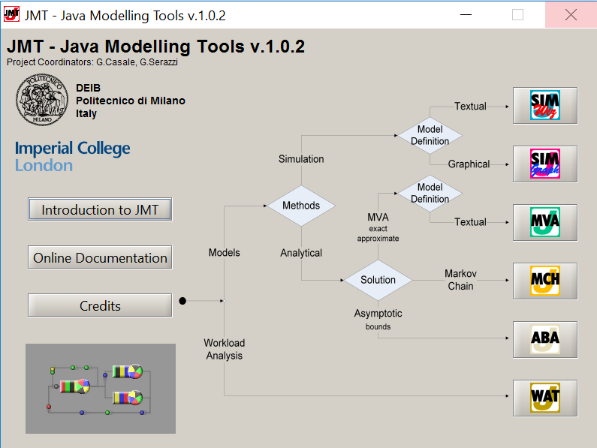
JMT Start Screen
Simulator

Slide 8
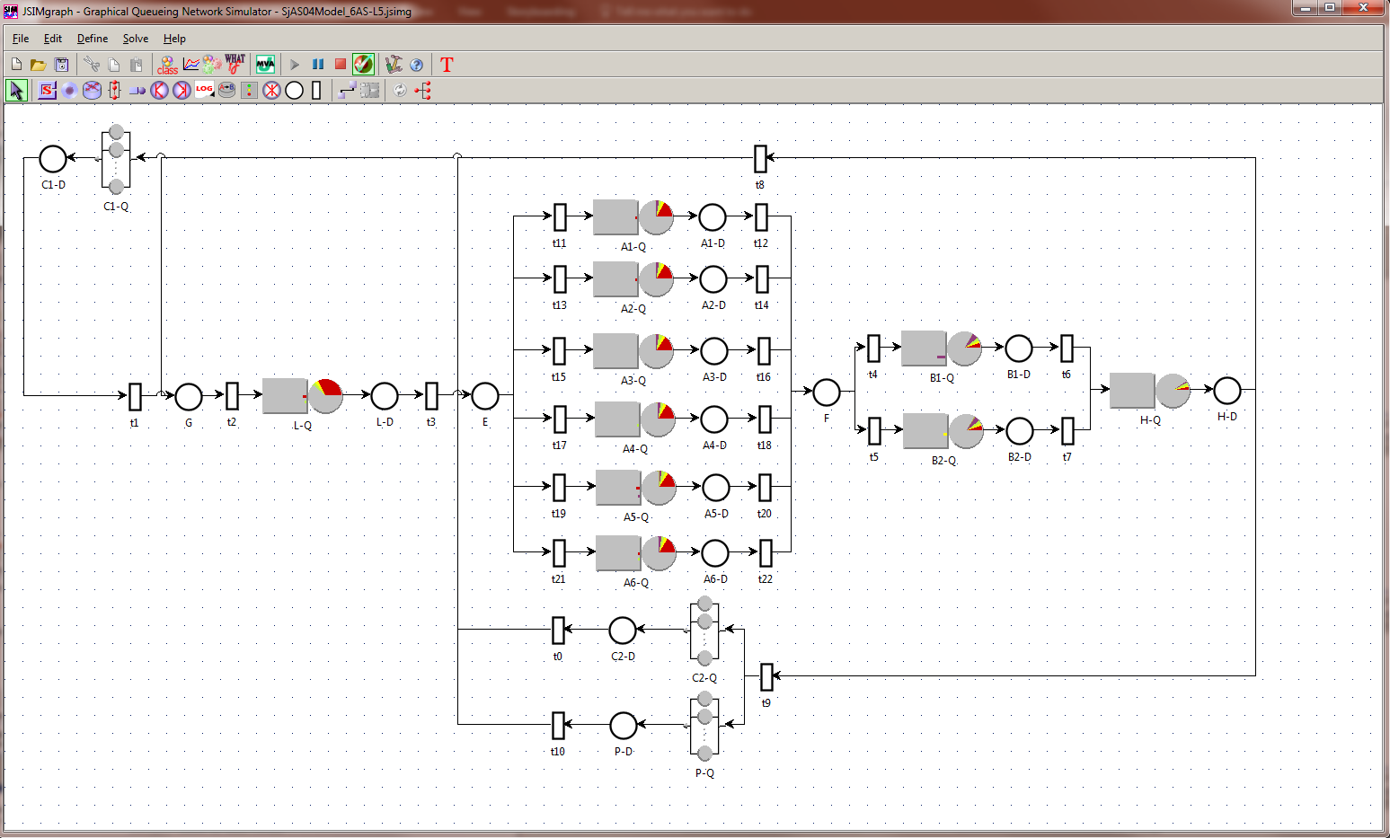
JSIMgraph: QN & PN simulation

Slide 9

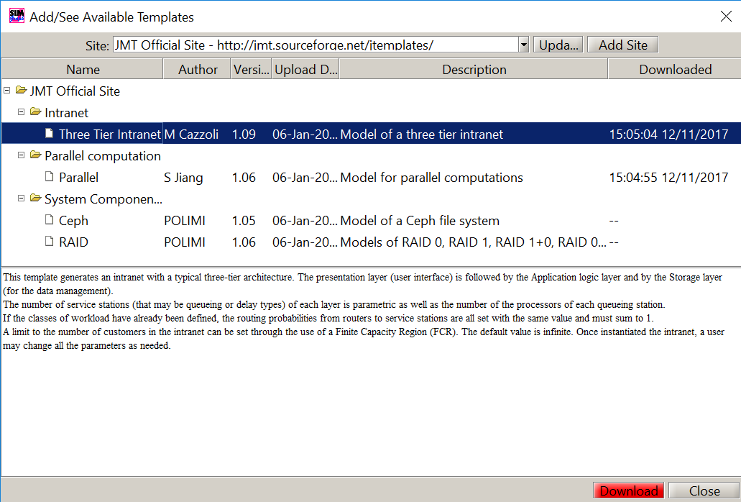
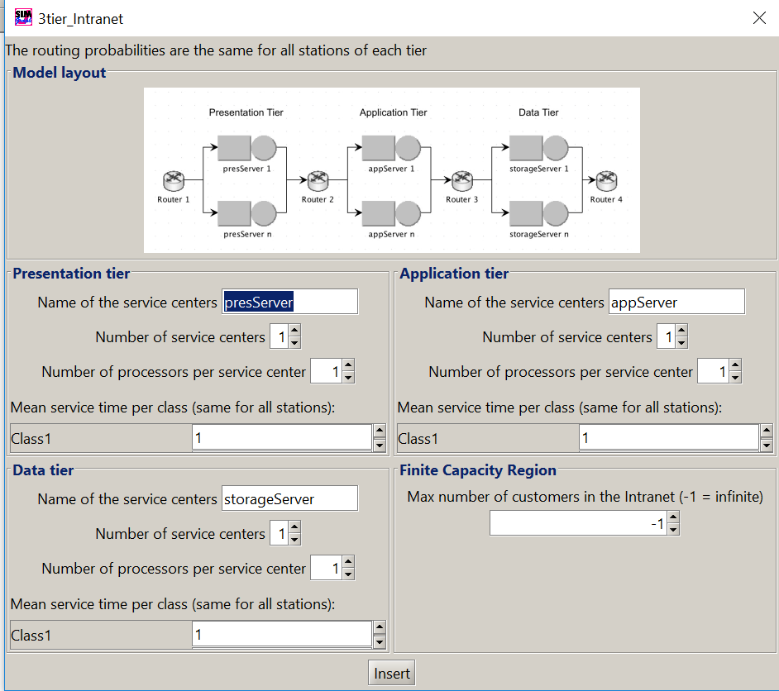
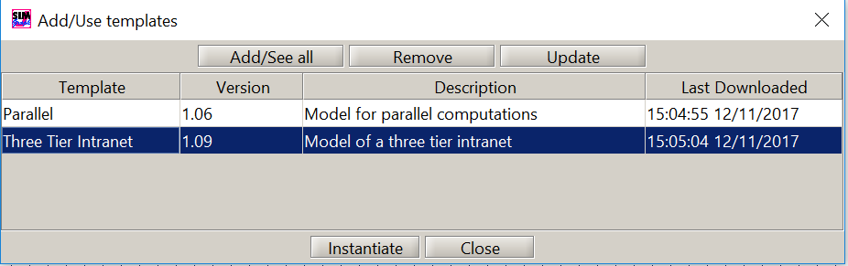
Templates

Slide 10
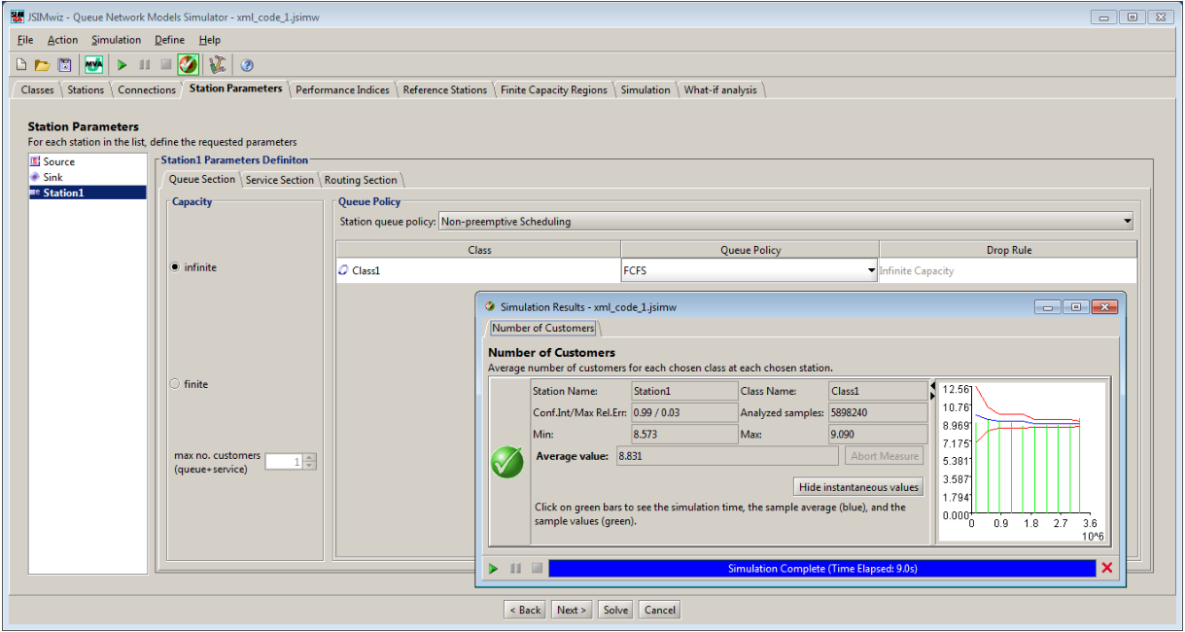
JSIMwiz: wizard-based user interface

Slide 11
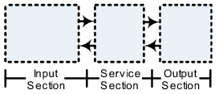
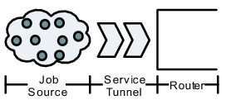
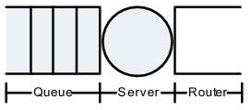
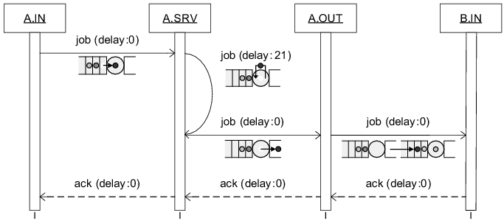
JSIMengine: discrete-event simulator
Simulation components defined by 3 sections
Discrete-event simulation of section messaging
component sections
external arrivals (open class)
queueing station
serve
admit
route
complete

Slide 12


JSIMengine: JMT architecture
(also stores results)
CLI / XML
GUI
JABA, JMVA, JWAT
JSIMwiz
JSIMgraph
XML
XSLT
XML
Status
Update
XSLT
JMT framework
JSIMengine

Slide 13
JMVA: analytical solver
  Normalizing constant
    RECAL O(N^{M})
    CoMoM O(NlogN)
Analysis of product-form queueing networks
Several exact and approximate algorithms
  Exact MVA
    Reiser & Lavenberg O(N^{R})
    Load-dependent O(N^{2R})
  Approximate MVA O(1)
    Chow
    Bard-Schweitzer
    AQL
    Linearizer
    De Souza-Muntz
  N: jobs
  M: stations
  R: classes

Slide 14
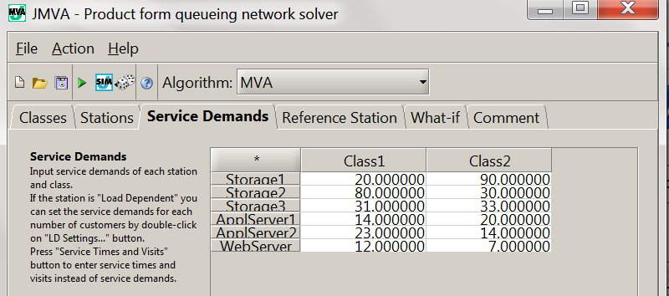
JMVA: model parameterization

Slide 15
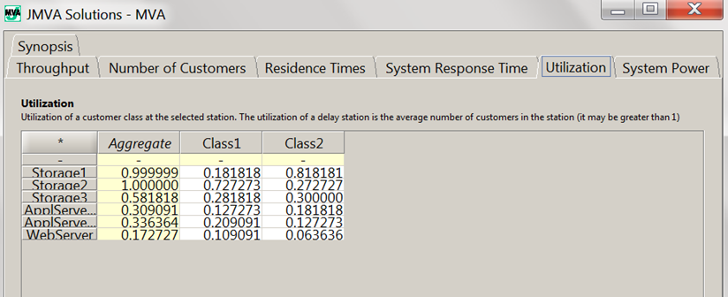
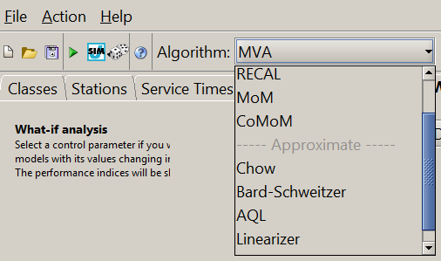
JMVA: solutions
Choice of solution algorithm

Slide 16
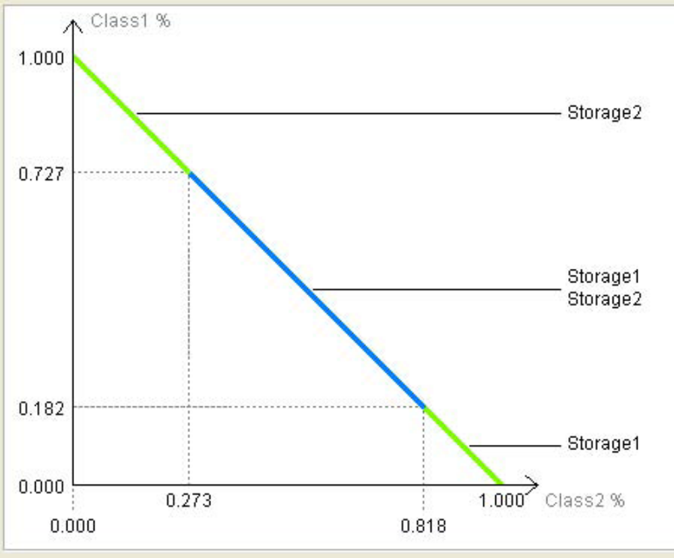
JABA: bottleneck identification
bottlenecks
Common saturation sector
Fraction of class 2 jobs that
saturate two resources concurrently

Slide 17
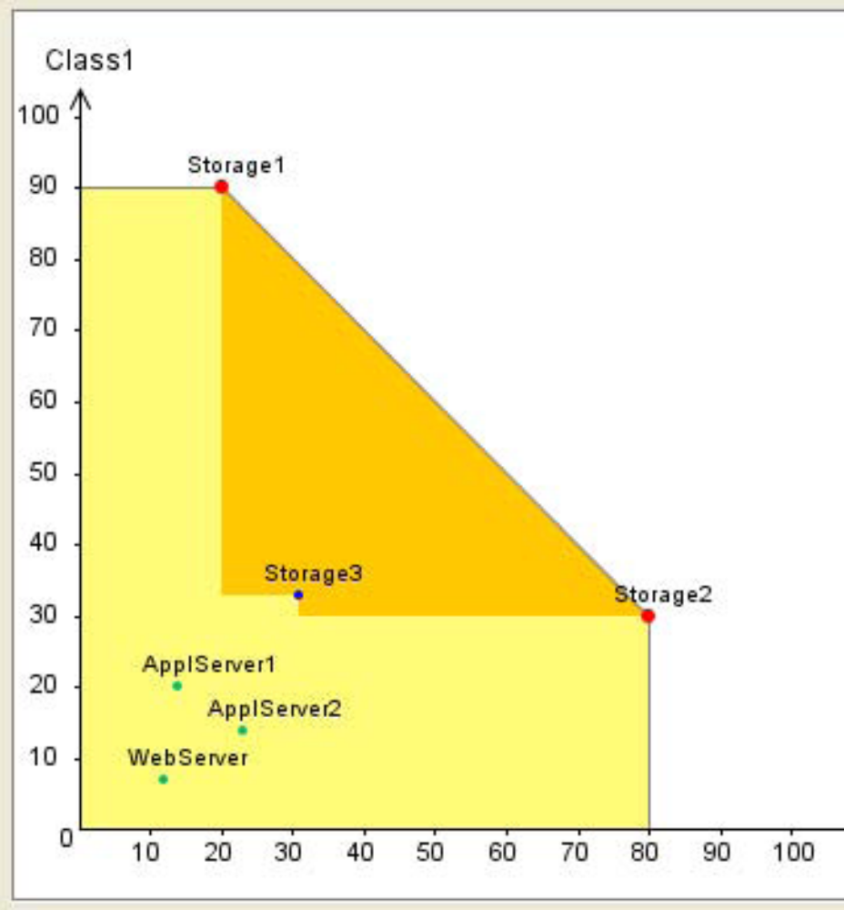
JABA: bottleneck identification
3-class model
Service demands of class 2
bottlenecks
Service demands of class 1

Slide 18
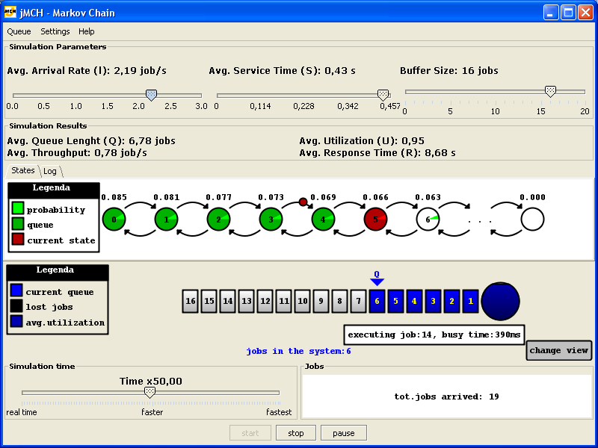
JMCH: Markov chain animation

Slide 19
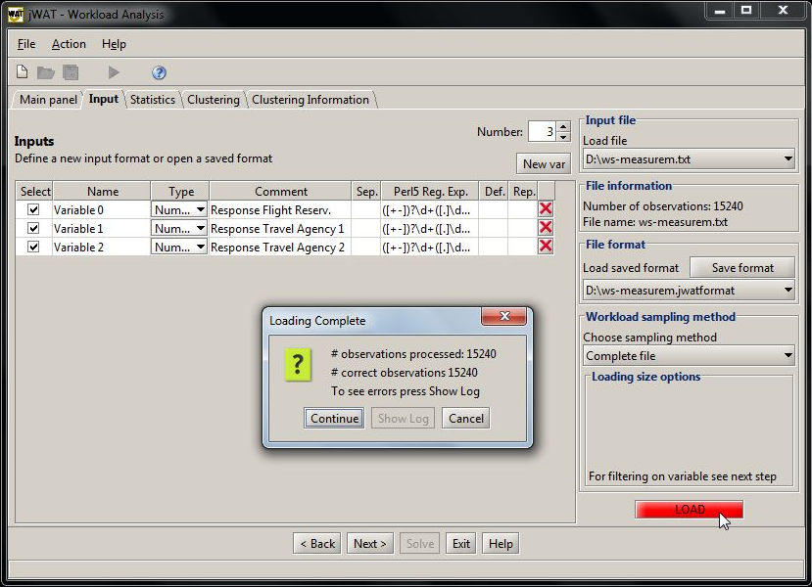
JWAT: workload characterization
Column-Oriented Log File
Specify Format
Data Format
Templates
Load Data
G.Casale – G.Serazzi

Slide 20
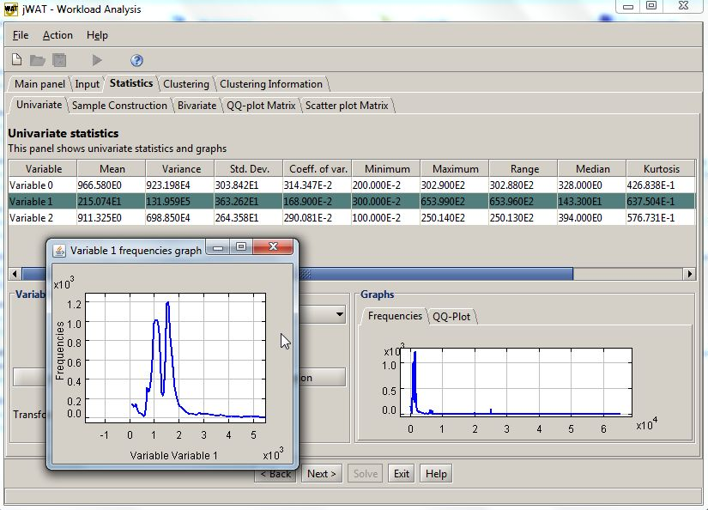
JWAT: workload characterization
Scatter plots
c=std. dev. /mean
Histogram
Hyper-Exp
(c >1)

Slide 21
Activity 1: getting started

Slide 22
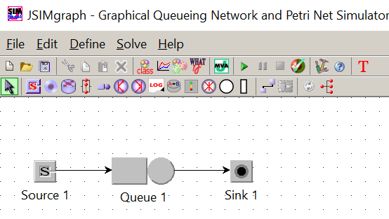
Hands-on activity: M/M/1
Arrival rate: λ=0.5 job/s (Exponential)
Service rate: µ=1.00 job/s (Exponential)
Goal: verify M=>M property

Slide 23
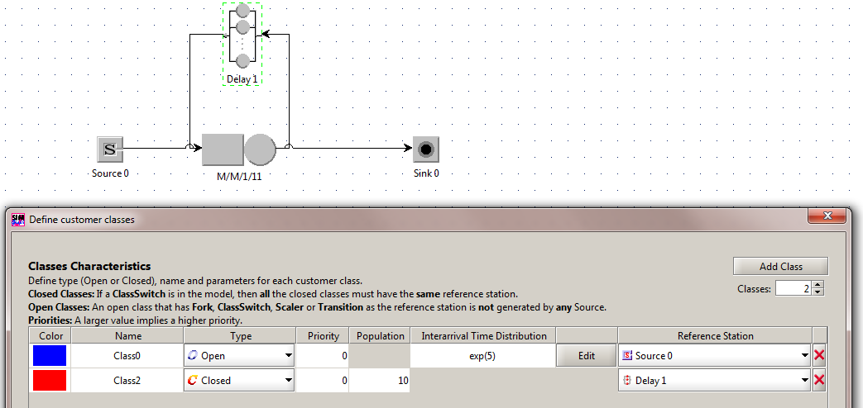
Class definition
Open, closed, and mixed workloads
Priorities and reference stations
Reference stations
used for system metrics
Visits at node = TPUTnode/TPUTref
ref is the reference station
Reference station for closed class
Reference station for open class

Slide 24
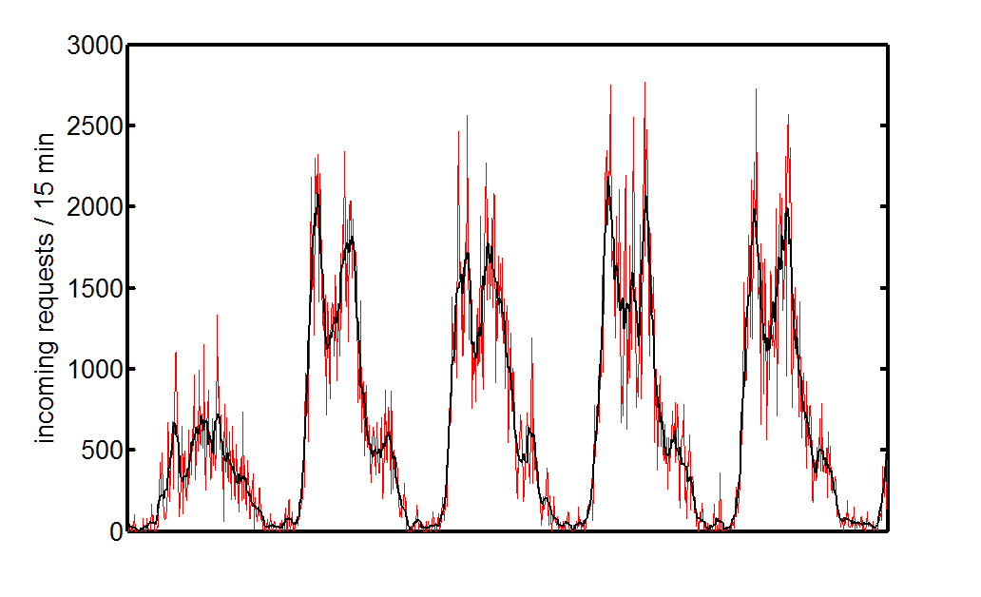
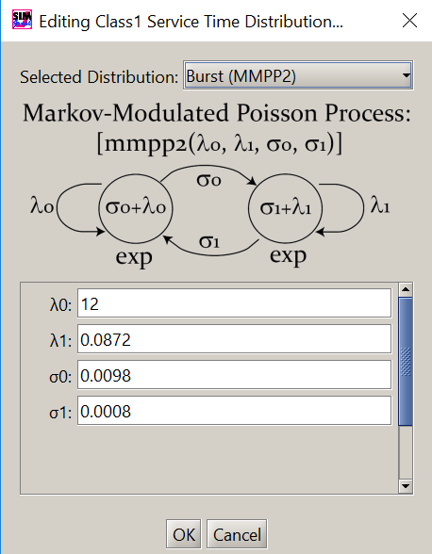

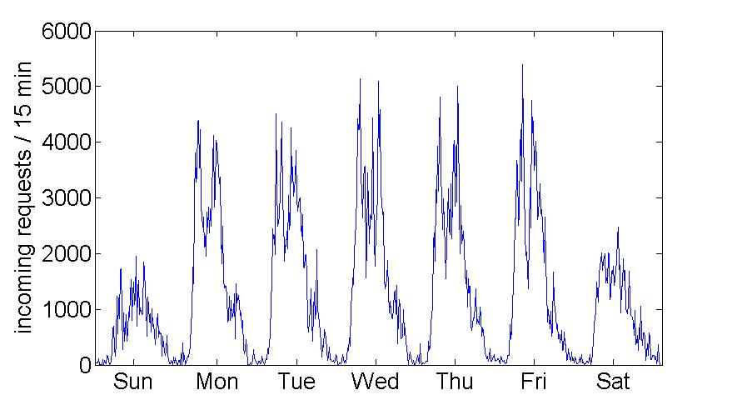
Arrival distribution
Time-Varying Peaks of User Activity
Will the system
sustain the load?
High
Performance
Sun
Mon
Tue
Wed
Thu

Slide 25
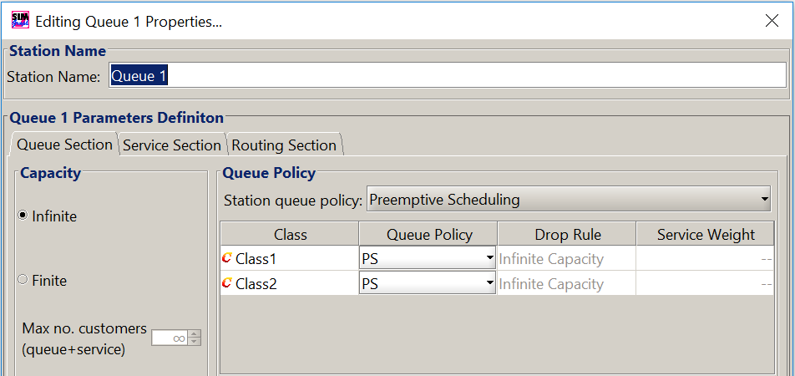
Queue section
Non-preemptive scheduling: FCFS, LCFS, RAND, SJF, LJF, SEPT, LEPT, HOL (FCFS priority)
Preemptive scheduling: PS, GPS, DPS
Buffer size

Slide 26
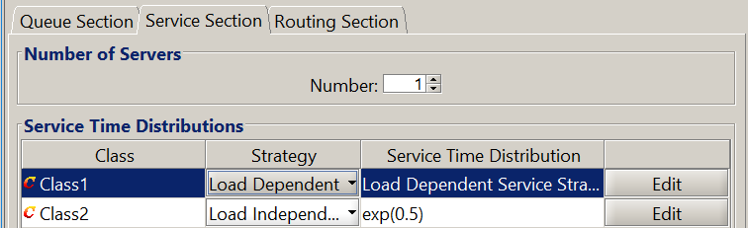
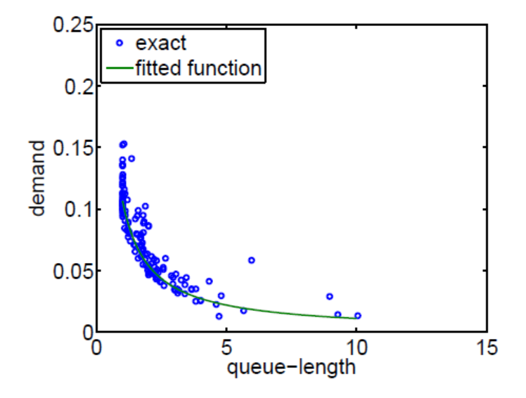
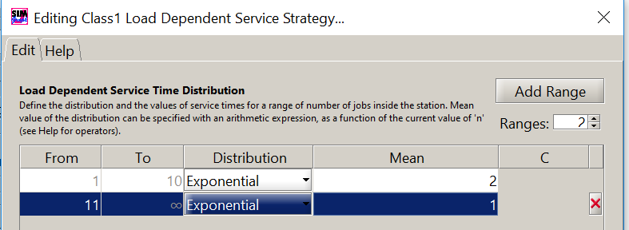
Service section
number of servers
exponential rate = 0.5

Slide 27
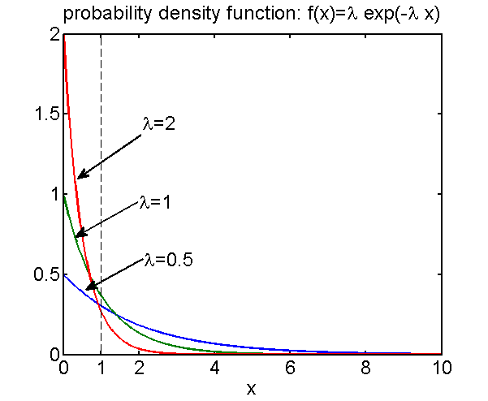
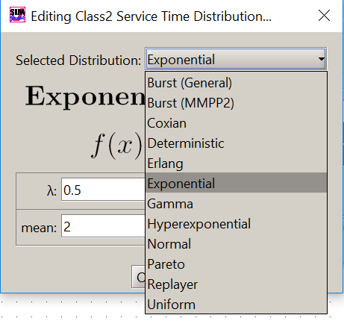
Service time distribution
External trace
Service time

Slide 28
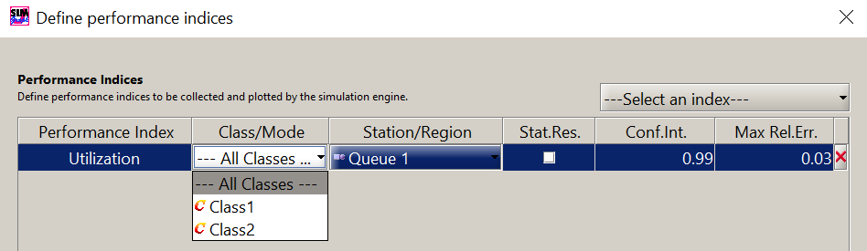
Perf. Indices
19 types of performance indices
  Utilization, residence time, response time
  Throughput, firing rates, drop rates, …
Granularity: system, station, class, mode, sink

Slide 29
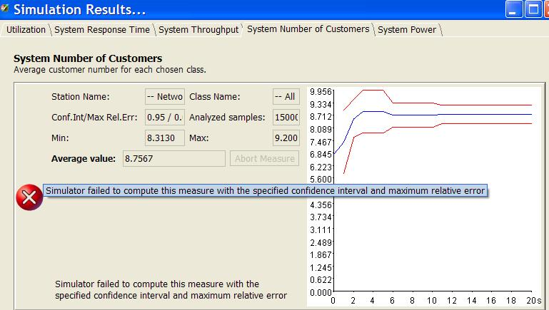

Sim. Results
performance indices
confidence interval
transient duration
the number of
samples needed is greater than the
max allowed
actual sim. parameters
default values
of parameters

Slide 30
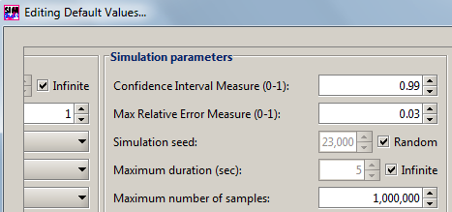
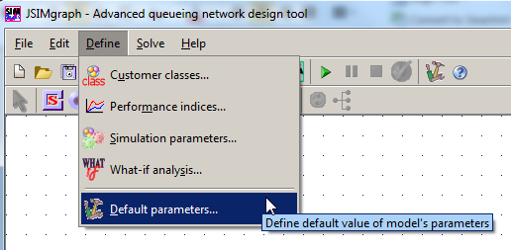
Statistical analysis
Automated (overridable) simulation stop
maximum
relative error
confidence level
30
traditional control
parameters

Slide 31
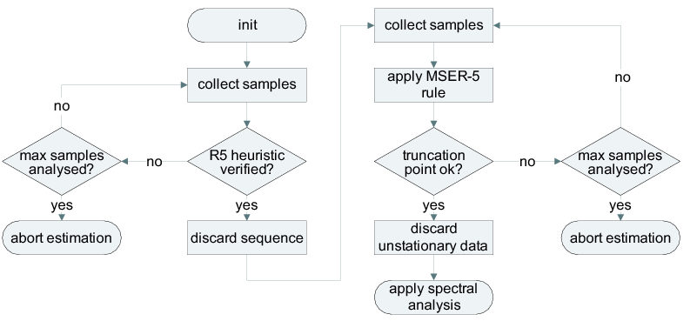
Transient filtering
Intelligent filtering of simulation data
  R5 heuristics, spectral analysis, MSER-5 rule, ...
[Spratt, M.S. Thesis, 1998]
Transient
(Steady State)
[Pawlikowski, CSUR, 1990]
[Heidelberger&Welch, CACM, 1981]

Slide 32
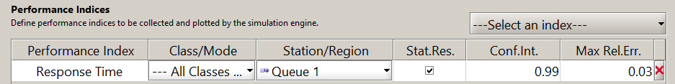
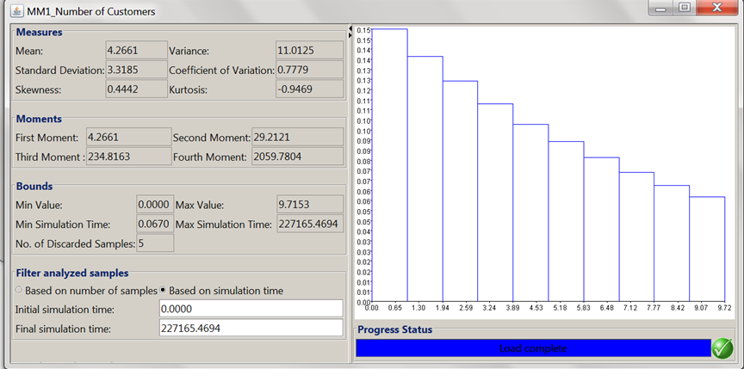
Detailed statistical results
Response time percentiles, buffer overflow probability, departure process moments, …

Slide 33
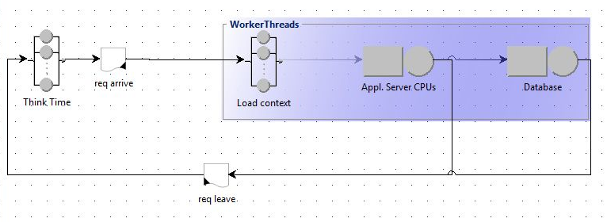

Loggers
Simulation events can be traced in CSV files
logger
logger
job id (same throughout simulation)
global.csv
job class

Slide 34
Activity 2:
Load balancing

Slide 35
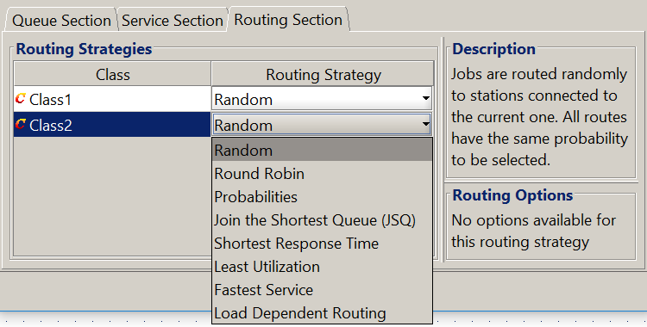
Routing section or ….
Probabilistic routing
State-dependent routing: JSQ, SRT, LU, FS
Load-dependent probabilistic routing

Slide 36
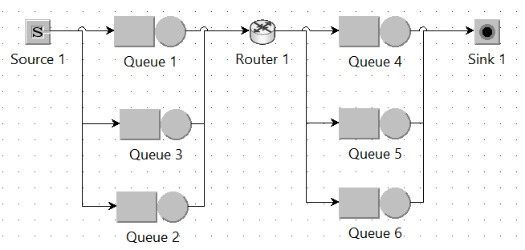
… router node
Router node also allows to specify routing
  Applies policy across multiple input queues
  Same policies as routing section

Slide 37
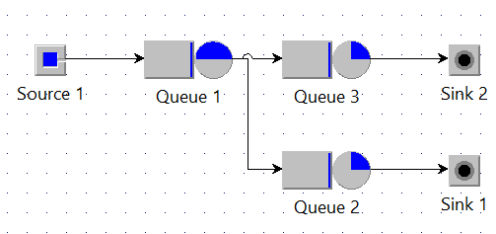
Hands-on activity: load balancing
We add two queues to the M/M/1 model.
Goal: compare round-robin and probabilistic load-balancing

Slide 38
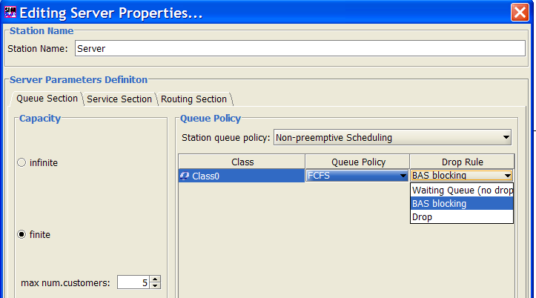
Blocking after service
station with finite capacity
selection of the
BAS policy
BAS policy:
requests are blocked in the
sender station when the max
capacity of the receiver
is reached
max number of requests
in the station

Slide 39
Activity 3:
Parameter sweeping

Slide 40
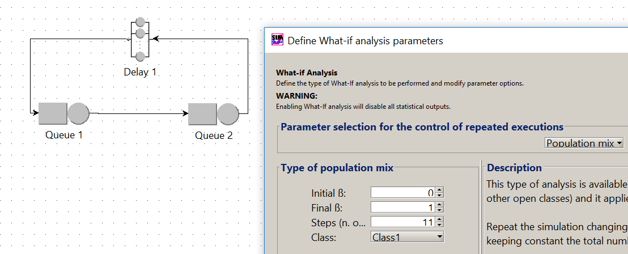
Hands-on activity: bottleneck switch
Analysis of bottleneck switch
Measure: Number of Customers
Demands: Queue 1: 10 , 5; Queue 2: 5 , 9

Slide 41
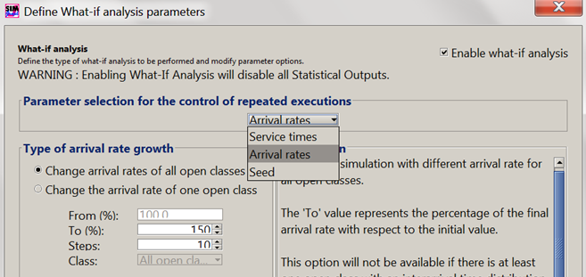
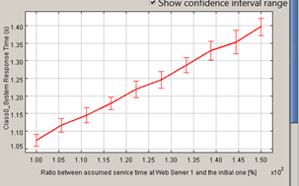
What-If analysis
Perform repeated executions automatically
10 JSIM
invocations

Slide 42
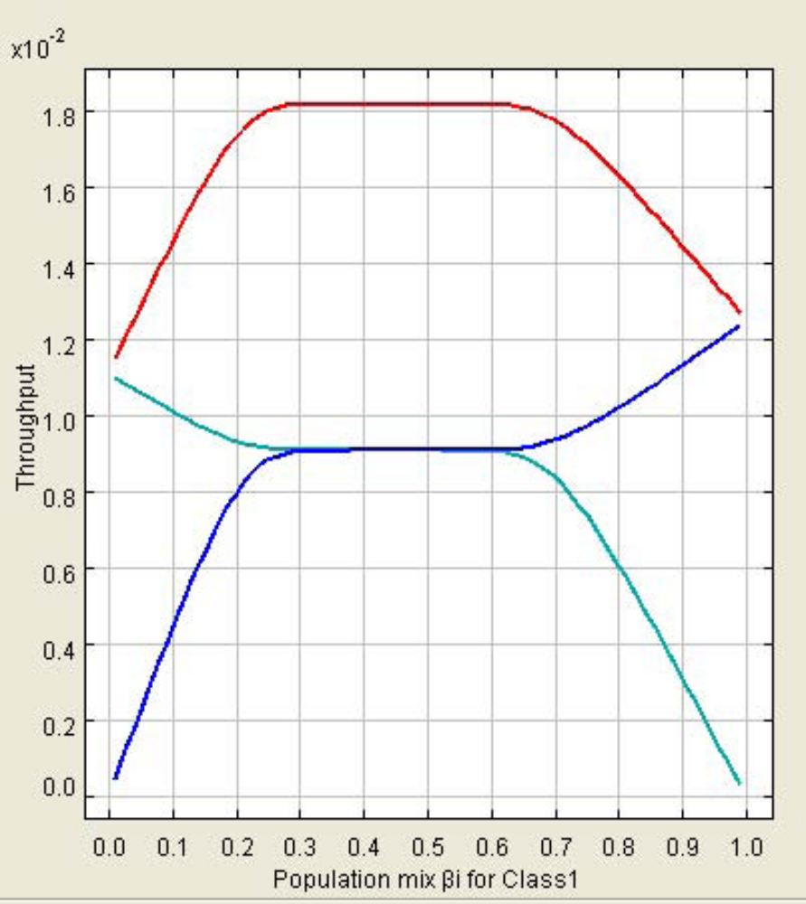
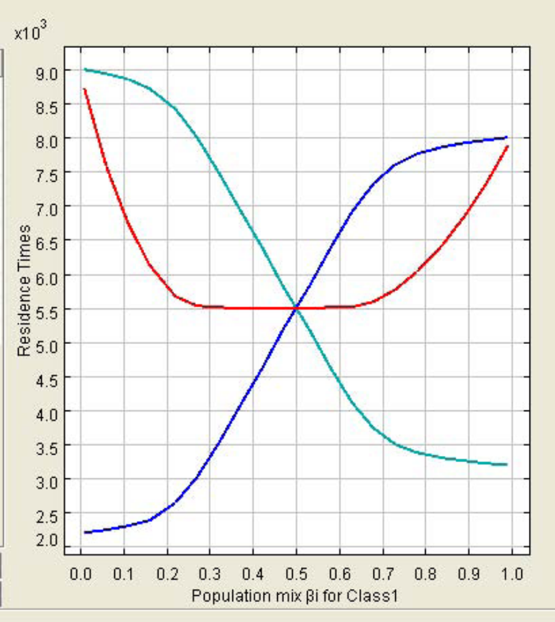
JMVA: What-If
system
Common
Saturation Sector
0.0181 job/ms
system
5.5 ms
equiload
class 1
class 2
Common
Saturation Sector
class 2
0.48
class 1
Throughput
Response times

Slide 43
Activity 4:
Capacity constraints

Slide 44
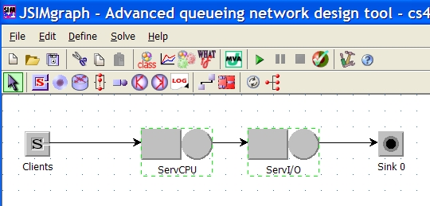
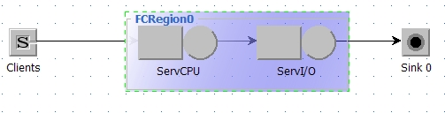
FCR definition
Thread limits via finite capacity regions (FCRs)
step 1 – select the
components
of the FCR
step 2 – set the FCR
region with constrained
number of customers
queue
drop

Slide 45
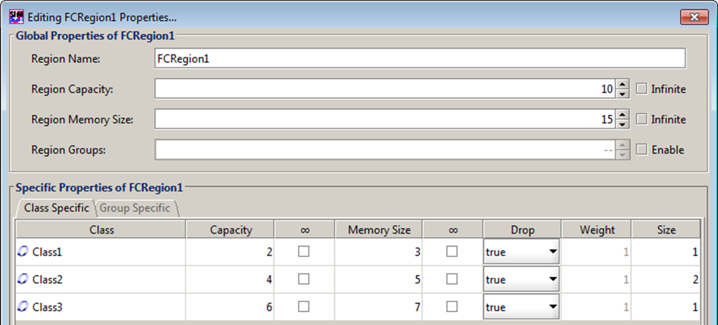
FCR parameters
Capacity constraints: total, per-class, per-group
Memory constraints: jobs have sizes and must fit
Global job capacity
Global memory capacity
Memory Capacity
Job Size
max number of requests
per class in the FCR
drop the requests when the region
capacity is saturated

Slide 46
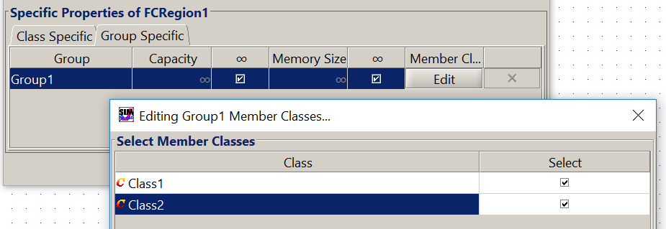

FCR groups and indices
Group-specific constraints (i.e., for subset of classes)
Dedicated performance indices

Slide 47




Support for PN elements
Places and transitions
Queueing Petri nets

Slide 48


PN sections & modes
JMT design paradigm extends to PN elements
Mode: a rule to activate and fire a transition

Slide 49

Hand-on activity: FCRs vs QPNs
Arrival rate: λ=0.99 job/s
Service rate: µ=1.00 job/s
Goal: restrict max 1 job inside queue

Slide 50
Activity 5:
Workflows & fork-join

Slide 51


Class-switching
A job can change its class during the simulation
  Workflows, re-entrant lines, track path-wise perf., …
Example: re-entrant line

Slide 52

Fork-Join elements
Jobs split into tasks carrying id of the parent job
Support for:
  nested fork-joins
  multiple join points
  finite capacity between fork-join
  advanced policies (e.g., quorum)
JMT can compute
Response time at Sink 2 only

Slide 53

Advanced fork
Branch prob.: randomize no. tasks and output links
Random subset: choose n-out-of-k output links
Class Switch: assign new class to forked tasks

Slide 54


Advanced join
Quorum: wait a subset of tasks (of the same job)
Guard: like quorum but requires given class mix
Scaler: join then fork again

Slide 55

Semaphore
Block first N tasks forked from the same job
Upon arrival of the Nth, unblock and let the other pass

Slide 56

Case Study: YARN Capacity Scheduler
YARN ― Yet Another Resource Negotiator

Slide 57

Case Study: YARN Capacity Scheduler
Detailed model using QPN
  Nested FCRs (JobQueue, MapQueue, RedQueue)
  14.13% error in trace-driven simulation [D. Ardagna et al., ICA3PP’16]

Slide 58

Case Study: YARN Capacity Scheduler
Simplified model using QN
  Class switching between Map tasks and Reduce tasks

Slide 59
Conclusion

Slide 60

Coming Soon (>= version 1.0.3)
Customer impatience
Ability to parallelize JMT on multiple cores
  Collect samples or run what-ifs in parallel
  Internal simulation remains single-threaded
New load-balancing policies
  Power of k choices
  SITA
  …
TreeMVA in JMVA for sparse networks
Tutorial supported by the European Union’s Horizon 2020 research and innovation programme under grant agreement No. 644869.

